Slide 1
Clustering

Slide 2
Clustering
Given n samples (patterns), group them into k groups (clusters) in such a way that all patterns in a single cluster have some relation (similarity) to one another and objects not in the same clusters are different (dissimilar)
No prior knowledge of the labels or classes of the pattern (unsupervised)

Slide 3
Clustering

Slide 4
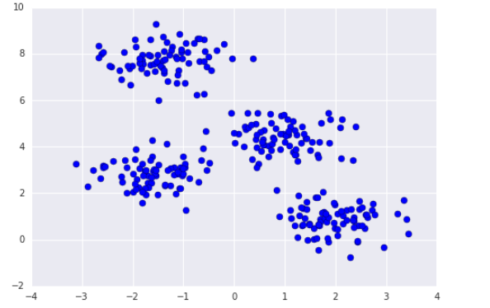
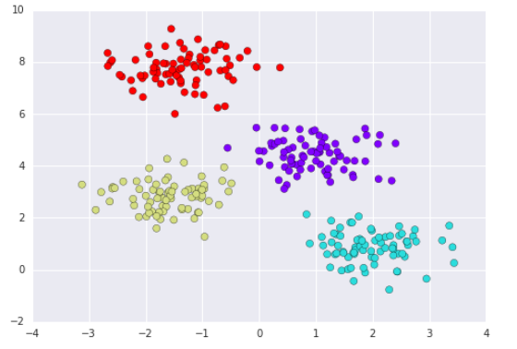
Unsupervised Learning - Clustering
Unsupervised learning is a machine learning technique that finds structure in data that is not labelled
Supervised learning can require extensive human input as the machine learns from cases that have been processed and labelled by humans
Clustering finds groups of samples that share similar characteristics
Usually this means groups that are clustered in multi-dimensional “feature space”

Slide 5
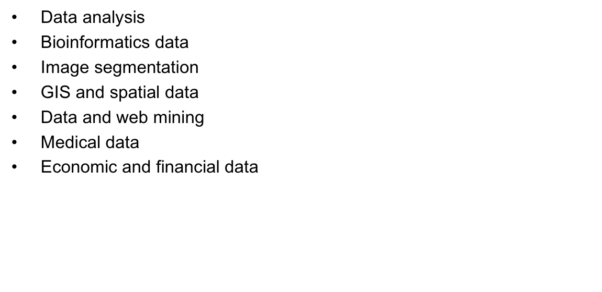
Clustering
Data analysis
Bioinformatics data
Image segmentation
GIS and spatial data
Data and web mining
Medical data
Economic and financial data

Slide 6
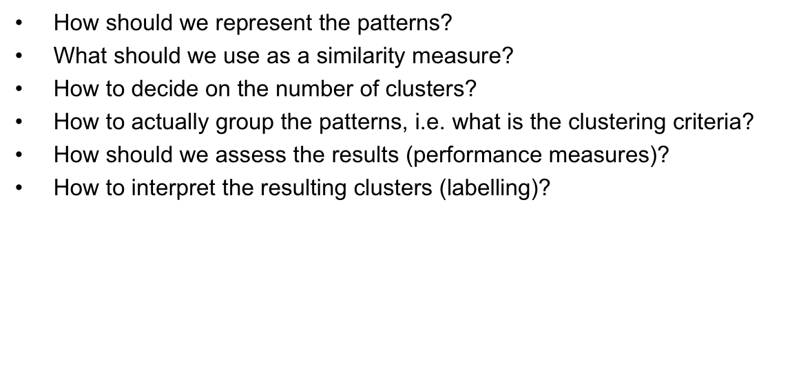
Issues
How should we represent the patterns?
What should we use as a similarity measure?
How to decide on the number of clusters?
How to actually group the patterns, i.e. what is the clustering criteria?
How should we assess the results (performance measures)?
How to interpret the resulting clusters (labelling)?

Slide 7
Representation
Patterns can be represented as multidimensional vectors, each dimension is a single feature.
The features can be quantitative or qualitative (qualitative can be handled by the appropriate measures).
Other representations include structures (tree like) or symbolic objects (logical conjunction of events)
We can also use strings to represent patterns in the syntactic approach.

Slide 8
Representation
Distance can be used as a measure of dissimilarity (review what we talked about back on distance measures).
There are other applications where similarity could be defined based on other concept than distance or proximity

Slide 9
Representation
Distance can be used as a measure of dissimilarity (review what we talked about back on distance measures).
There are other applications where similarity could be defined based on other concept than distance or proximity

Slide 10
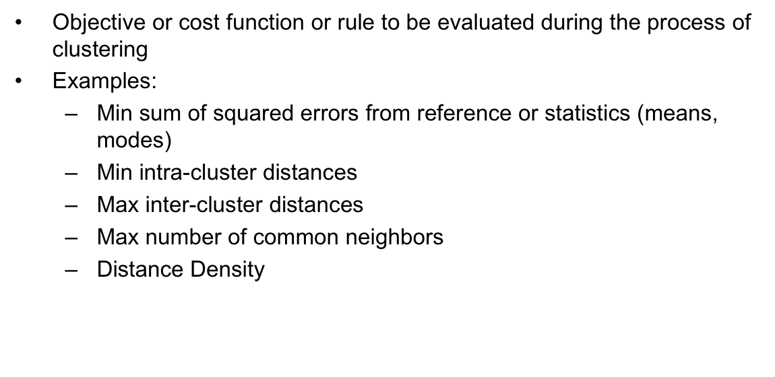
Clustering
Objective or cost function or rule to be evaluated during the process of clustering
Examples:
Min sum of squared errors from reference or statistics (means, modes)
Min intra-cluster distances
Max inter-cluster distances
Max number of common neighbors
Distance Density

Slide 11
Clustering algorithms
There are different types of clustering algorithms:
Hard clustering: data points are assigned to one group or another
Soft clustering: data points are assigned a probability of belonging to one group or another
Similarity based clustering vs. feature based clustering:
Similarity: for N examples, and NxN distance matrix is input
Feature-based: for N examples, and NxD matrix (like a DataFrame) is the input
Flat vs. Hierarchical clustering:
Flat or partitional clustering: objects are organized into disjoint groups (number of groups, K, must be specified)
Hierarchical clustering: a nested tree of partitions is created

Slide 13
Hierarchical algorithms
Hierarchical: nested sets of clusters
Sometimes called connectivity based clustering
Agglomerative: start with each pattern in one cluster and merge close clusters until stopping criteria is satisfied
Divisive: start with all patterns in one cluster and keep on dividing the dissimilar ones

Slide 14
K-means Clustering
Most commonly used clustering algorithm in this type
Choose K cluster centers [m1,mk]by selecting randomly K patterns
Repeat
Distribute patterns among clusters using similarity measure
Compute new cluster centers using the current memberships
Until convergence
Convergence can be:
No change in centers
Minimum decrease in objective function X
Minimum reassignment of patterns to new cluster centers

Slide 15
K-means Clustering
here are variants of the k-means, that permit merge and split of resulting clusters, or different use of objective function
One variant that can handle categorical data is k-modes, it uses modes rather than mean

Slide 16
K-means Clustering
randomly choose k examples as initial centroids
while true:
create k clusters by assigning
each example to closest centroid
compute k new centroids by averaging
examples in each cluster
if centroids don’t change:
break

Slide 17
K-means Clustering
Pros
Simple
Fast for low dimensional data
Cons
Can’t handle non-globular clusters
Will not identify outliers
Restricted to data which has notion of center
Will have problem with clusters of different sizes

Slide 18
Evaluation Measures
External
If we know the labels of the true clusters, accuracy, F-measure can be calculated by constructing the contingency table using the a priori clustering to compare to resulting clustering
Entropy: the degree to which each cluster consists of objects of a single class
Internal
Evaluating how well the results of a clustering algorithm without reference to external information
Two types of measures:
Cluster Cohesion (compactness, tightness): how closely related are the patterns in the same cluster
Cluster Separation(isolation): how well separated the cluster is from other clusters
Example: silhouette coefficient

